Slide 1
P
ROJECT
M
ANAGEMENT
Project Skills H3029

Slide 2
Objectives
Understand the difference between a project and project management
Develop a working knowledge of how to properly scope a project for success
Schedule project activities using a Gantt chart

Slide 3
What is a Project?
A project is a sequence of unique, complex, and connected activities having one goal or purpose and that must be completed by a specific time, within budget, and according to specifications.

Slide 4
Project Management Criteria
Projects are oriented towards a goal.
There is something unique about every project.
Projects have a finite duration.
Projects require coordination of interrelated activities.

Slide 5
What is Project Management?
Project management is a set of principles and tools for
  Defining
  Planning
  Executing
  Controlling . . . and
  Completing a PROJECT

Slide 6
Why is Project Management Important?
Organize your approach
Generate a credible schedule
Track progress and control your project
Identify where to focus your efforts
Identify problems early – before they are crises
Saves you TIME….MONEY
If you fail to plan, PLAN TO FAIL

Slide 7
Scoping the
Project
Scoping the
Project
Developing the
Plan
Launching the
Plan
Monitoring &
Controlling
Closing Out the
Project
Adapted from Weiss, J.W., and Wysocki, R.K. 1992. 5-Phase Project Management:
A Practical Planning and Implementation Guide. Reading, MA: Addison Wesley.
Five Phases of Project Management

Slide 8
Scoping the
Project
Scoping the
Project
Developing the
Plan
Launching the
Plan
Monitoring &
Controlling
Closing Out the
Project
Adapted from Weiss, J.W., and Wysocki, R.K. 1992. 5-Phase Project Management:
A Practical Planning and Implementation Guide. Reading, MA: Addison Wesley.
Five Phases of Project Management

Slide 9
State the Problem/
Opportunity
Establish the
Project Goal
Define the
Project Objectives
Identify the
Success Criteria
List Assumptions,
Risks, Obstacles
Adapted from Weiss, J.W., and Wysocki, R.K. 1992. 5-Phase Project Management:
A Practical Planning and Implementation Guide. Reading, MA: Addison Wesley.
Scoping The Project

Slide 10
Scoping Document
A short, crisply phrased piece of information covering
-- what is to be done
  -- why it is to be done
  -- value it provides if it is done

Slide 11
Scoping Document Example
Problem/opportunity
Project name, supervisor or manager
Singular Project Goal
Objectives that are Specific, Measurable, Assignable, Realistic, Time based (SMART)
Success criteria
Assumptions, risks, obstacles

Slide 12
Scope the Project: Problem/Opportunity
A statement of fact that everyone in the organization will accept as true
Should communicate why the project should be accomplished

Slide 13
Scope the Project - Goal
A project has one primary goal: to give purpose and direction
  Defines the final deliverable and outcome
  States in clear terms what is to be accomplished
  Is a reference point for questions about scope and purpose of the project

Slide 14
Scope the Project –
Objectives & Success Criteria
SMART Objectives
  Specific
  Measurable
  Assignable
  Realistic
  Time-related
Success Criteria
  Clearly states the bottom-line impact
  Quantifies outcomes so success can be measured

Slide 15
Scope the Project: Assumptions, Risks
Identify factors that might affect the outcome or completion of the project
Used to alert management to factors that may interfere with project work
Types of assumptions and risks
  Technological
  Environmental
  Interpersonal
  Cultural
  Political

Slide 16

Scope the Project
Create a scoping document for your project
ACTIVITY #1

Slide 17
Five Phases of Project Management
Scoping the
Project
Scoping the
Project
Developing the
Plan
Launching the
Plan
Monitoring &
Controlling
Closing Out the
Project
Adapted from Weiss, J.W., and Wysocki, R.K. 1992. 5-Phase Project Management:
A Practical Planning and Implementation Guide. Reading, MA: Addison Wesley.

Slide 18
Developing The Plan
Identify Project
Tasks (WBS)
Estimate Task
Duration
Determine Resource
Requirements
Construct/Analyze
Project Network
Prepare the
Project Proposal

Slide 19
Planning the Project:
Work Breakdown Structure (WBS)
A WBS is the functional decomposition of a system
Breaks the project into chunks of work at a level of detail that meets planning and scheduling needs

Slide 20
Prepare at home (level 1 task)
  Create Grocery List (level 2 task)
  check pantry for needed items (level 3 task)
  check refrigerator for needed items
  check items in refrigerator for expiration date
  Determine method of payment
Transport to store
  Select method of transportation, e.g., car
  Select route
  Drive to store
  Park
Prepare at store
Select method of holding groceries
Plan for gathering groceries
etc.
WBS Example: Grocery Store

Slide 21
WBS Completeness
Status/completion are measurable
Clearly defined start/end events
Activity has a deliverable
Time/cost easily estimated
Activity duration within acceptable limits
Work assignments are independent

Slide 22

Project Planning Activity
ACTIVITY #2
Create a work break down structure (WBS) for the project you identified in the scoping document. Identify and sequence tasks.

Slide 23
Project Planning: Resources
People - skills and value
Facilities
Equipment
Money
Materials
Time

Slide 24
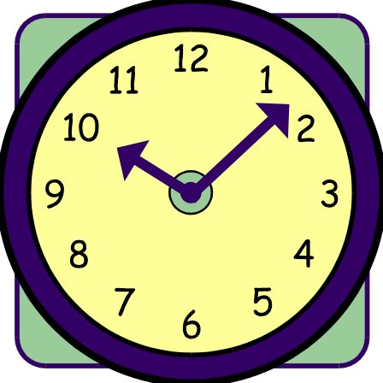
Duration - Estimation
Similarity to other activities
Historical data
Expert advice

Slide 25
Duration Is a Cause of Variation
Sources of variation:
  Varying skill levels
  Unexpected events
  Efficiency of work time
  Mistakes and misunderstandings

Slide 26
Resource Activity
Identify all the resources required for each activity
Estimate the duration of each task

Slide 27

Dependencies
Linkage between and among activities/tasks
Dependencies create the backbone of the project network

Slide 28
Dependencies
Finish to start
Predecessor Task: A
Successor Task: B
Arrow head indicates dependency relationship: Task B cannot begin until Task A is complete
A
B

Slide 29
Gantt Chart
Visual scheduling tool
Graphical representation of information in WBS
Show dependencies between tasks, personnel, and other resources allocations
Track progress towards completion

Slide 30
List all tasks and milestones from the WBS along the vertical axis
List time frame along the horizontal axis
Activity 1
Activity 2
Milestone
Time Frame: day 1 day 2 day3
Building a Gantt Chart

Slide 31
Activities: Create box the length of each activity time duration
  E.g., activity one is scheduled from day1-day3
Milestones: Create a diamond on the day the milestone is scheduled to be completed
Activity 1
Activity 2
Milestone
Time Frame: day 1 day 2 day3
Building a Gantt Chart

Slide 32
Dependencies: Show dependencies between activities with arrows
  E.g., activity 2 cannot start until activity 1 is complete
Activity 1
Activity 2
Milestone
Time Frame: day 1 day 2 day3… day 23
Building a Gantt Chart

Slide 33
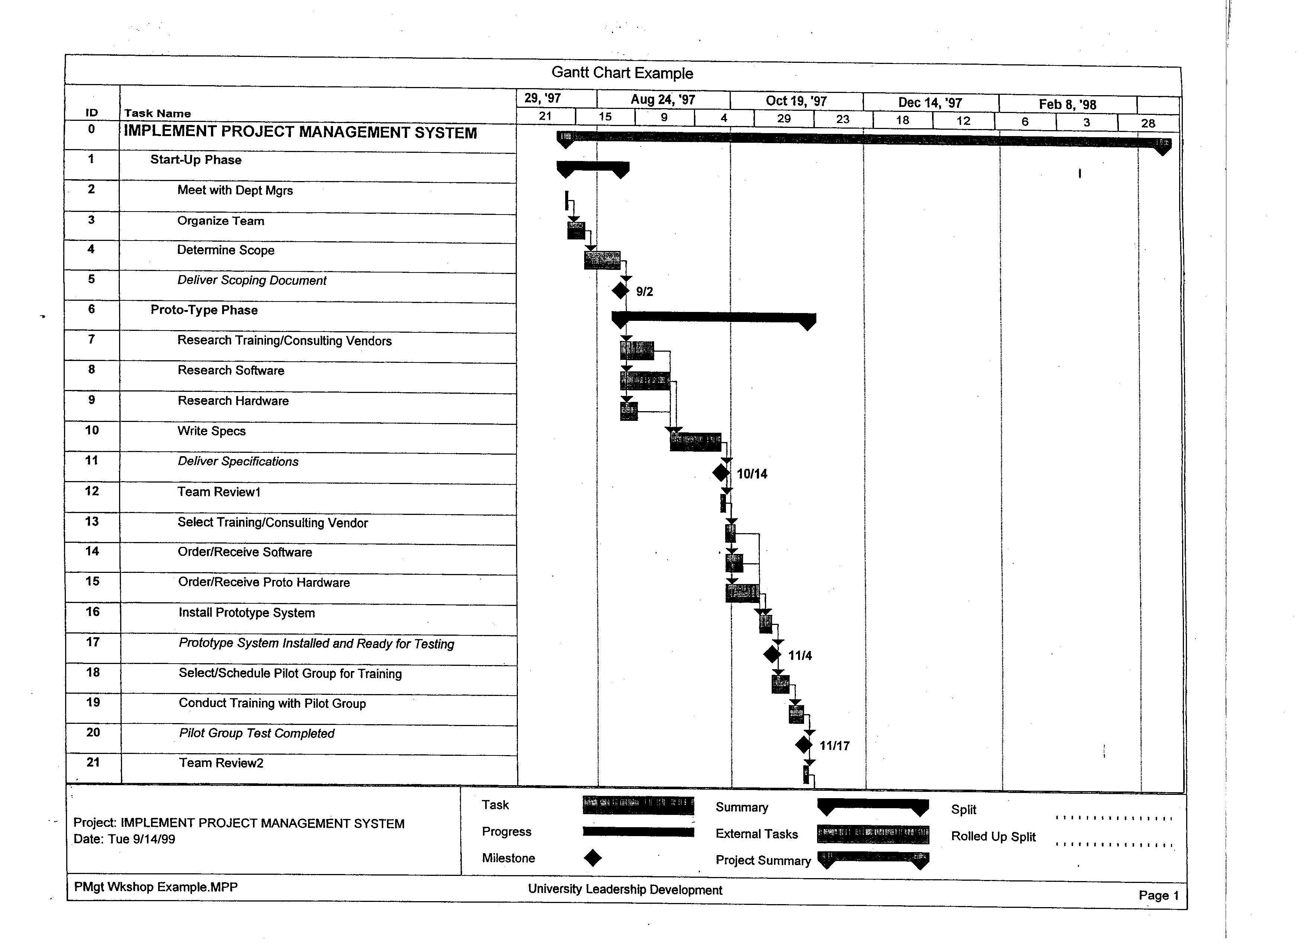

Slide 34
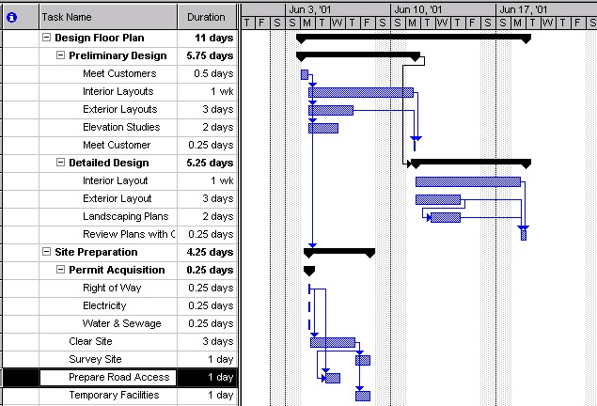
Gantt Chart – Example
Arrows indicate task dependencies:
Predecessor task
Successor task
Tasks
Bars indicate time requirement
Estimated time to complete a task

Slide 35
Responsibility Matrix
Creates accountability by assigning each task to a person
Task | Joe | Mary | Renee
Activity 1 |  | x
Activity 2 | x
Activity 3 |  |  | x

Slide 36
Gantt Chart Activity
ACTIVITY #3
Based on the WBS (tasks, durations, and dependencies) create a Gantt Chart

Slide 37
Look Out for the Creepers!
Scope Creep - Change is constant – must be accommodated (Comes from the customer)
Hope Creep - Check status reports
Effort Creep - Status reports record progress, but there is no change in the % completed
Feature Creep – Similar to Scope Creep but comes from the provider.

Slide 38
Progress
2/3 Time - 3/4 Progress
1/3 time - 1/4 progress
Time
Standard S Curve

Slide 39
Progress
About 30% of the work done
70% to 80% of the time gone by
Time
The Curve To Avoid!

Slide 40
Deliverables
ACTIVITY #1
Create a Scope document for your project
ACTIVITY #2
List your WBS for the project you identified in activity # 1
ACTIVITY #3
Create a Ghantt Chart based on WBS listed in activity # 2
ACTIVITY #4
Create your Project Plan or Proposal

